Slide 1
ProcFS Overview
Created & Presented By: Janvi

Slide 2
Introduction
/proc is one of the filesystem which is also called as a process information pseudo-file system. It doesn’t contains the ‘real’ files but runtime system information i.e system memory , devices mounted , hardware configuration and more. A lot of system utilities are mainly call to the files in this directory.
The file size of all of the files in this directory have a file size of 0, with just exception of some files.
The directory name is /proc
You can go into the directory by doing cd /proc

Slide 3
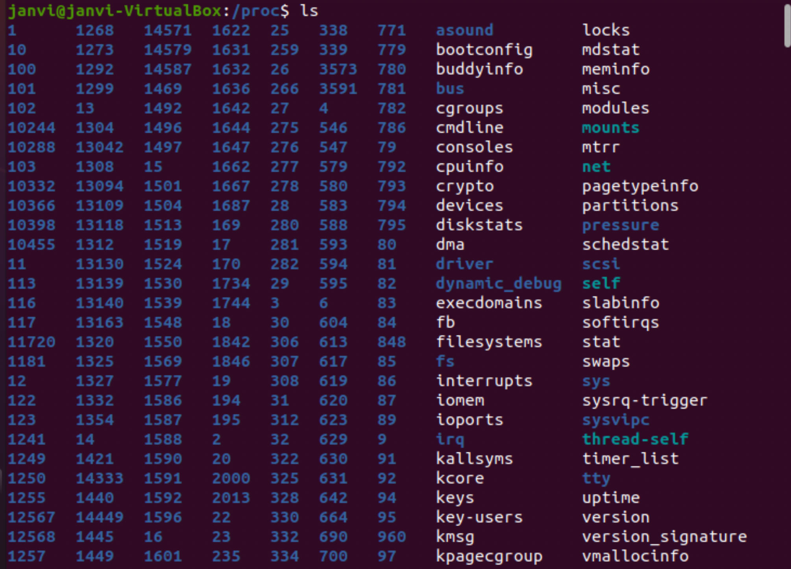
These are the files present in the proc directory.
All the numbered files are the Process ID running itself.

Slide 4
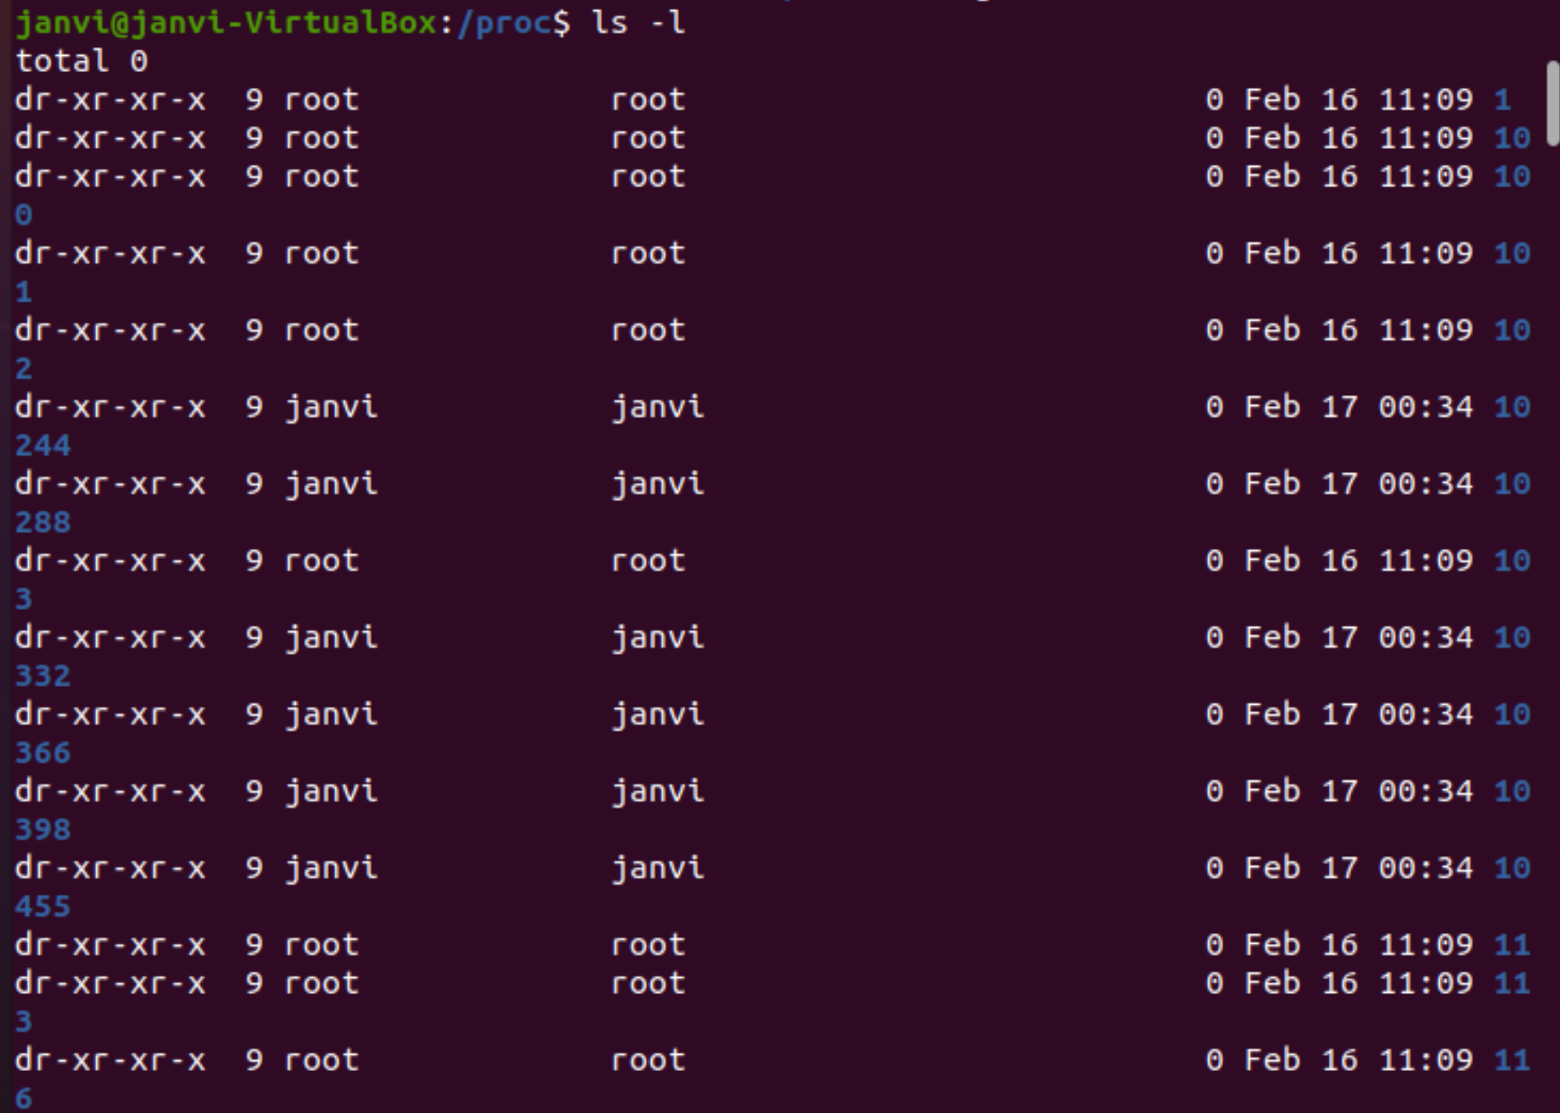
Process Related Subdirectories

Slide 5
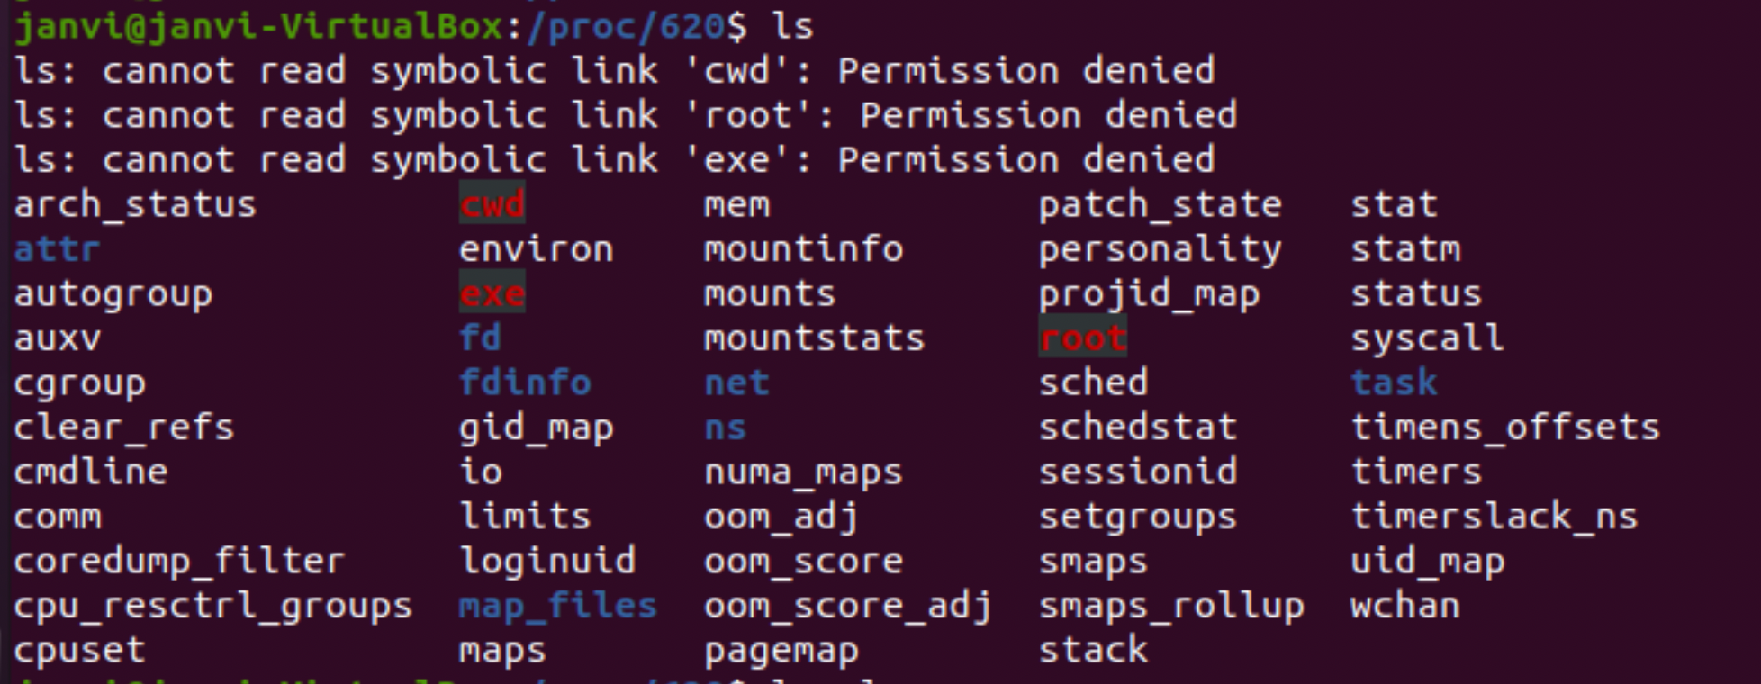
All these files are having the size 0.But what these contains the information and how it contains information is that these files doesn’t contain any sort of data , it just acts as a pointer to where the actual process are running. For example , I am just portraying one of the process ID files here. These are the files that are present in one of the Process ID directory.

Slide 6
All the files present in any of process id is there because of some purpose and contents that each of the file serve there. I am going to explain a few:
cmdline - command line arguments
cpu - current & the last cpu that was executed.
cwd - path to the current working directory (Required root permission))
environ - environment variables value
exe - link to the executable of that particular process.
mem - memory held by this process
stat - status of the process
statm - memory status information
maps - memory maps to executables and library files.
These are some of the files and to get to know about more , we can refer to the man page of the proc.

Slide 7
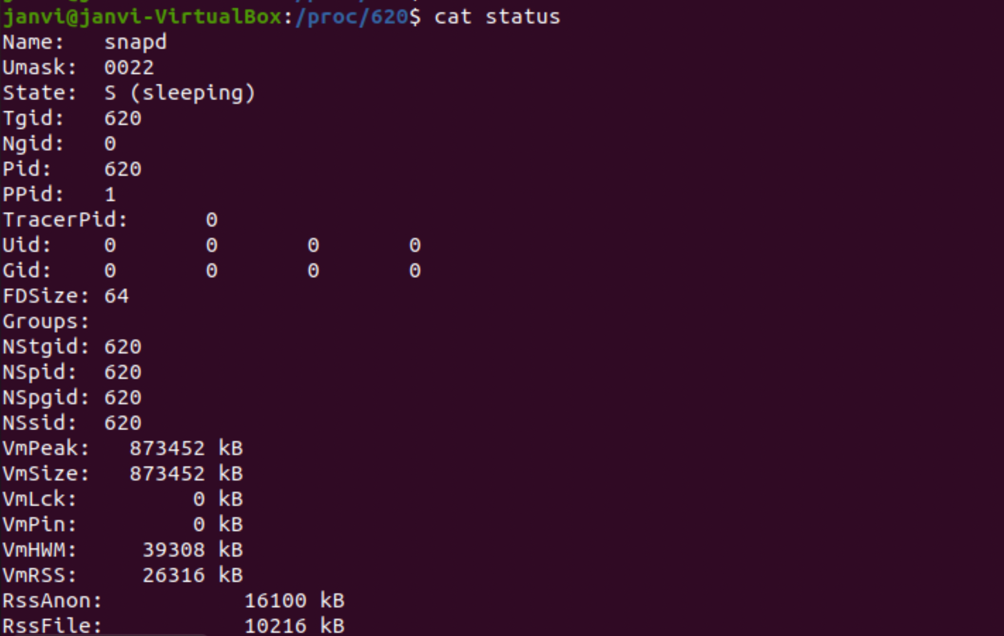

Slide 8
Kernel data
Kernel Data files give the information about the running kernel . The files that will be present on the system can vary from the system to system as these files depend on the kernel configuration and the loaded modules .
Kernel info in /proc is stored in the files like :
apm - advanced power management information
buddyinfo - Kernel memory allocator information
bus - Directory containing bus specific information
cmdline - Kernel command line
cpuinfo - Info about the CPU
devices - available devices
dma - Used DMS channels
filesystems - supported filesystems
driver - various drivers

Slide 9
fb - FrameBuffer Devices
Fs - file system parameters like ext4 , nfs and jbgd
ide - info about the IDE subsystem
Interrupts- interrupt usage
iomem - Memory map
Ioports - i/o port usage
Irq - irq to cpu affinity
Kcore - kernel core image
Kmsg - kernel msgs
Ksyms - kernel symbol table
locks - kernel locks
meminfo - memory info
modules - loaded modules
net - networking info
pagetypeinfo -Additional Page allocator information
partitions - table of partition known to the system

Slide 10
pci - Deprecated info of PCI bus (new way -> /proc/bus/pci/, decoupled by lspci
rtc - Real time clock
scsi - SCSI info (see text)
slabinfo - Slab pool info
softirqs - softirq usage
stat - Overall statistics
swaps - Swap space utilization
sysvipc - Info of SysVIPC Resources (msg, sem, shm)
tty - Info of tty drivers
uptime - Wall clock since boot, combined idle time of all cpus
version - Kernel version
video - bttv info of video resources
vmallocinfo - Show vmalloced areas

Slide 11
IDE Devices in /proc/ide
This subdirectory /proc/ide contains information about all the IDE devices of which that particular kernel is aware. There is one subdirectory for each IDE controller , the file driver and a link to the IDE Device that points to the device directory in the controller specific subtree.
The file “ drivers” one contain the information about the drivers used for the IDE devices.
The subdirectory contains more information that can be found in the IDE controller . These are named ide0, ide1 and so on. IDE controller consists of info about these things:
Channel - IDE channel
Config - configuration
Mate - mate name
Model - type/chipset of the IDE controller

Slide 12
The devices which are connected to these controller have separate subdirectories which consists of various files :
cache - stores the cache
capacity - capacity of the medium
driver - file driver and the version
geometry - physical and logical geometry of the device
Identify - device identify block
Media- media type
Model - device identifier
Settings - service setup
smart_thresholds - ide disk management thresholds
smart_values - ide disk management values

Slide 13
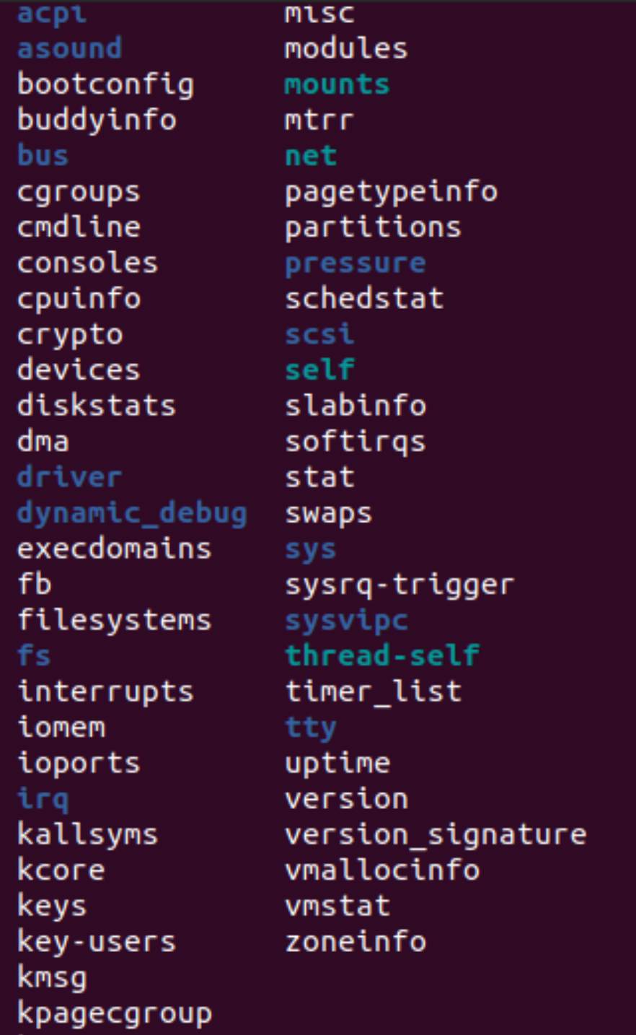
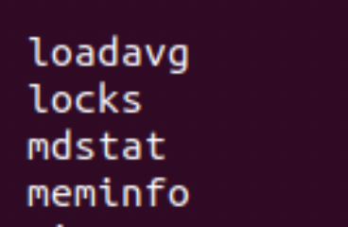
Kernel Data info file

Slide 14
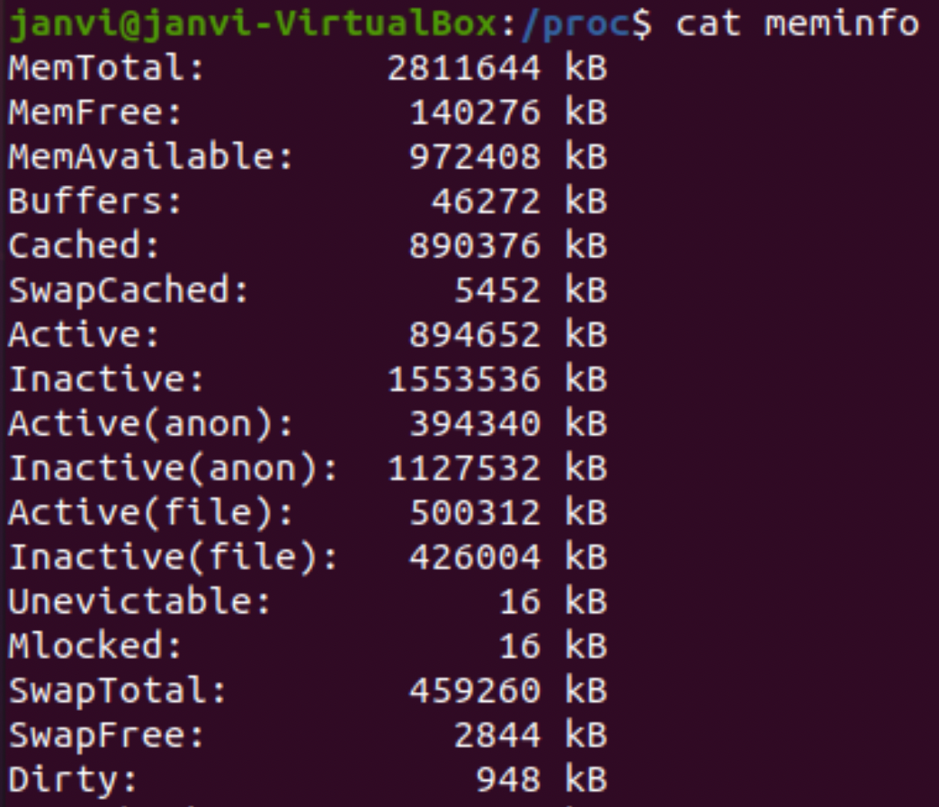
meminfo
MemTotal - Total Usage RAM
MemFree - total sum of HighFree+LowFree
MemAvailable - available memory for starting the new application.
Buffers- Temporary storage
Cached - in-memory cache for files.
SwapCached - Memory that was once swapped out.
Active -Memory used recently
Inactive -memory used less recently
HighTotal/Free -above ~860mb of physical memory.
LowTotal/Free - which can be used for everything
SwapTotal - total amount of swap space available
SwapFree - memory evicted from the RAM
Dirty - memory waiting to get written back to disk.

Slide 15
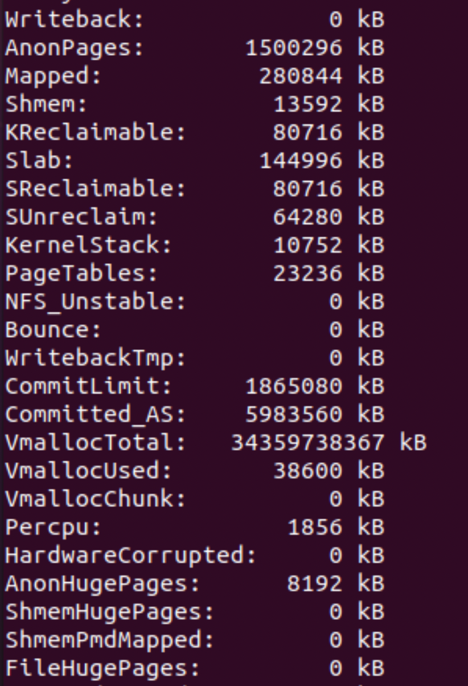
Writeback Memory which is actively being written back to the disk
AnonPages Non-file backed pages mapped into userspace page tables
HardwareCorrupted The amount of RAM/memory in KB, the kernel identifies as corrupted.
AnonHugePages Non-file backed huge pages mapped into user space page tables
Mapped files which have been mapped, such as libraries
Shmem Total memory used by shared memory (shmem) and tmpfs
ShmemHugePages Memory used by shared memory (shmem) and tmpfs allocated with huge pages
ShmemPmdMapped Shared memory mapped into userspace with huge pages
KReclaimable Kernel allocations that the kernel will attempt to reclaim under memory pressure. Includes SReclaimable (below), and other direct allocations with a shrinker.
Slabin-kernel data structures cache
SReclaimable Part of Slab, that might be reclaimed, such as caches
SUnreclaim Part of Slab, that cannot be reclaimed on memory pressure
PageTables amount of memory dedicated to the lowest level of page tables.
NFS_Unstable Always zero. Previous counted pages which had been written to the server, but has not been committed to stable storage.
Bounce Memory used for block device “bounce buffers”
WritebackTmp Memory used by FUSE for temporary writeback buffers
CommitLimit this is the total amount of memory currently available to be allocated on the system.
Committed_AS the amount of memory presently allocated on the system.
mallocTotal total size of vmalloc memory area
VmallocUsed amount of vmalloc area which is used
VmallocChunk largest contiguous block of vmalloc area which is free
Percpu Memory allocated to the percpu allocator used to back percpu allocations. This stat excludes the cost of metadata.

Slide 16
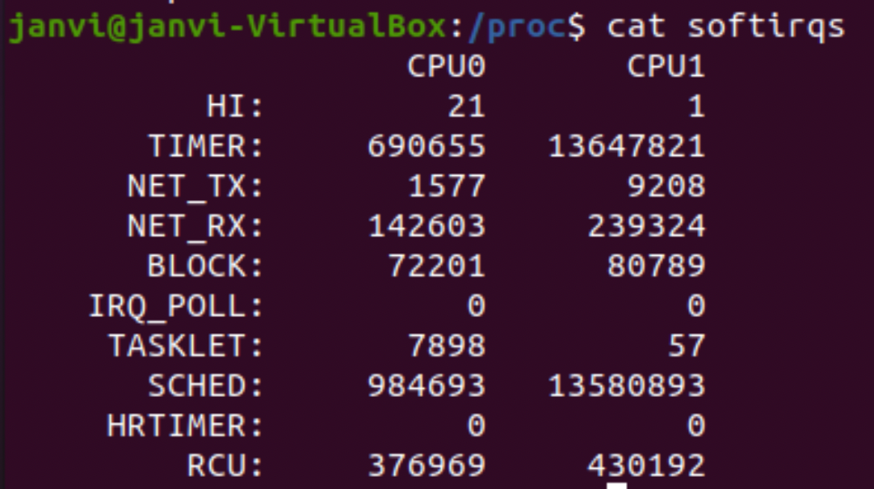
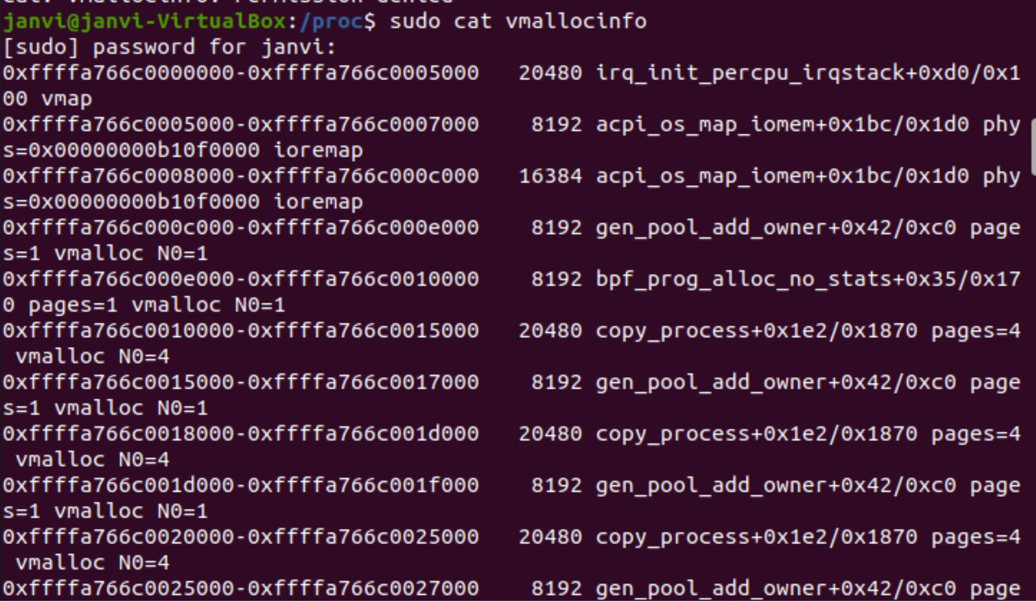
Softirqs:
Count of softirq handlers services for each CPU.
Vmallocinfo:
Provides information about vmalloced / vmaped areas.

Slide 17
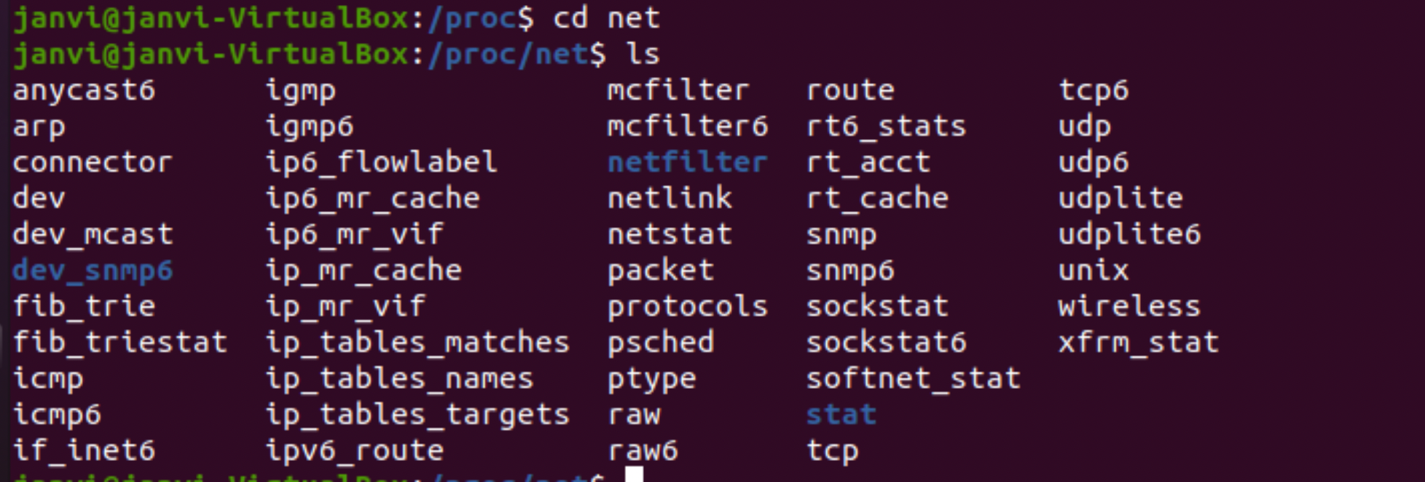
Networking information with /proc/net

Slide 18
IPv6 info is present in the directory in the files:
udp6 - UDP sockets (ipv6)
tcp6 - TCP sockets
raw6 - Raw device statistics
igmp6 - IP multicast addresses which is joined by the host.
If_inet6 - List of IPv6 interface addresses
Ipv6_route Kernel routing table for IPv6
Rt6_stats - Routing Statistics
sockstat6 - Socket Statistics
snmp6 - Snmp Data

Slide 19
Files that provide the Network information are:
Arp- Kernel ARP table
dev - network devices with statistics
dev_mcast - multicast group
dev_stat- network device status
netstat- network statistics
raw- raw device statistics
route - kernel routing table
rt_cache - Routing cache
unix - unix domain sockets
wireless - wireless interface data
netlink - list of PF-NETLINK sockets
Ip_mr_vifs - List of multicast virtual interfaces
psched- packet scheduler parameter

Slide 20
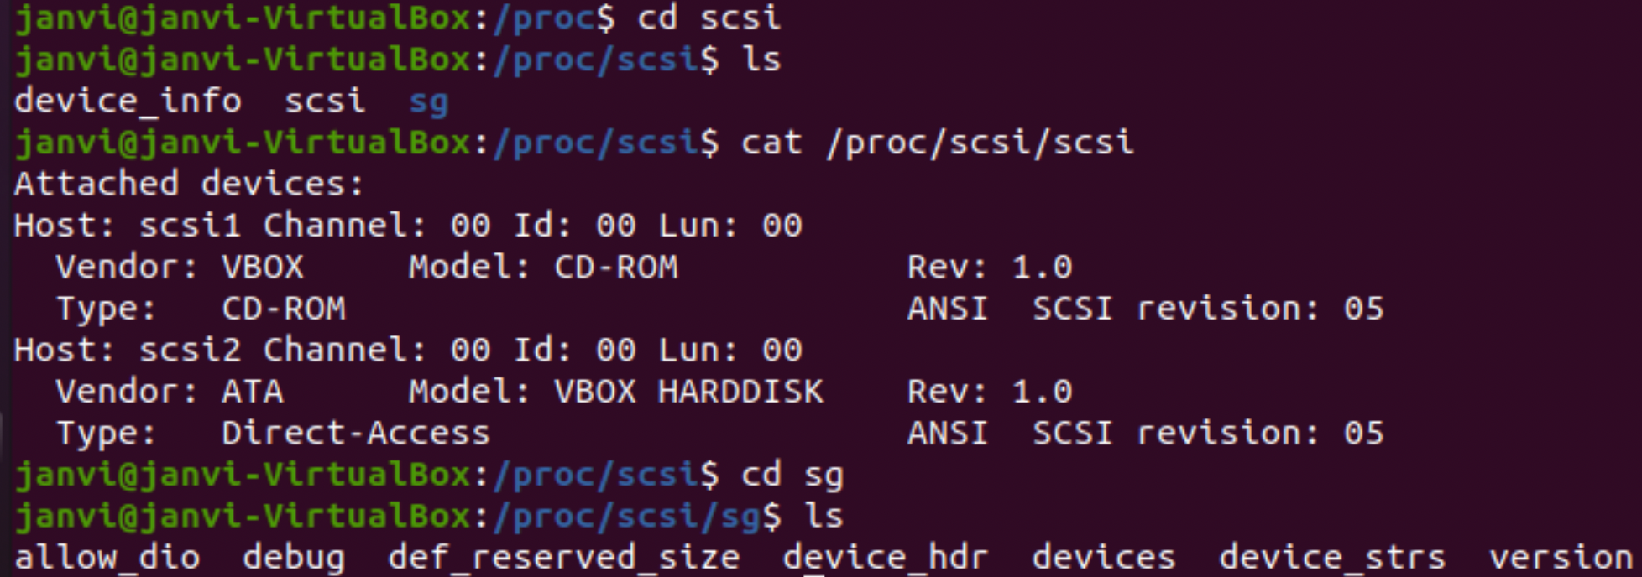
SCSI Info
The primary file in this directory is the scsi which contains a list of every recognized scsi device. We can get to know about the model , type of device , vendor , scsi channel and ID data .

Slide 21
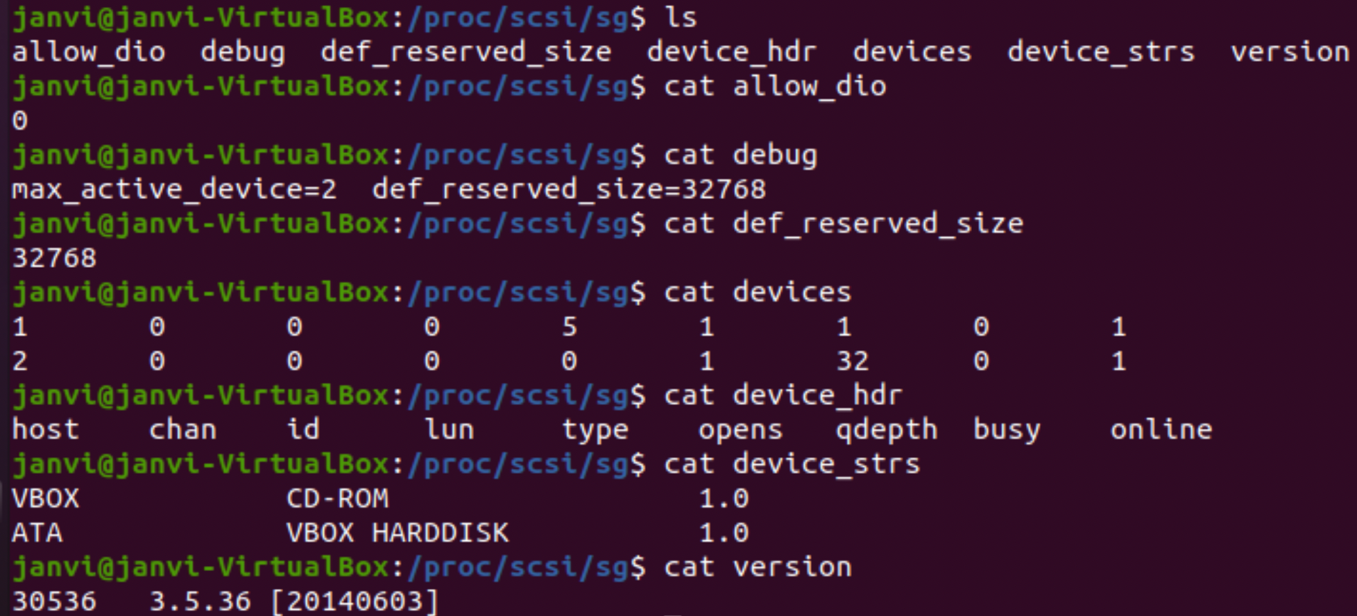

Slide 22
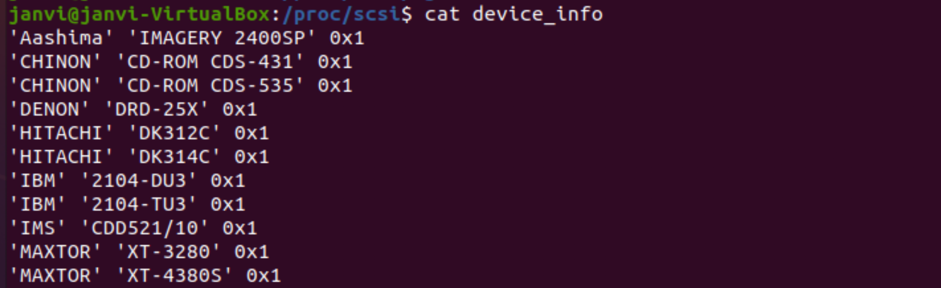

Slide 23
Parallel Port
Parallel port includes the ability to share one port between multiple device drivers.
This directory contains information about the parallel ports of your system.
/proc/parport
Files included:
autoprobe: Device ID information that has been acquired.
devices : list of the device drivers that are using that port. A + will appear by the name of the device currently using the port.
hardware: Parallel port;s base address
irq: IRQ number that passport is using for that port.

Slide 24
TTY info in /proc/tty
TTy is basically an abstract device. It can be referred to as input device such as a serial port or a virtual teletype where it allows users to interact with the system.
This consist information about the available and actually used tty’s.
This consist of files for :
Drivers: list of drivers and their usage.
ldiscs : registered line disciplines
driver/serial : usage statistic and status of single tty lines.

Slide 25
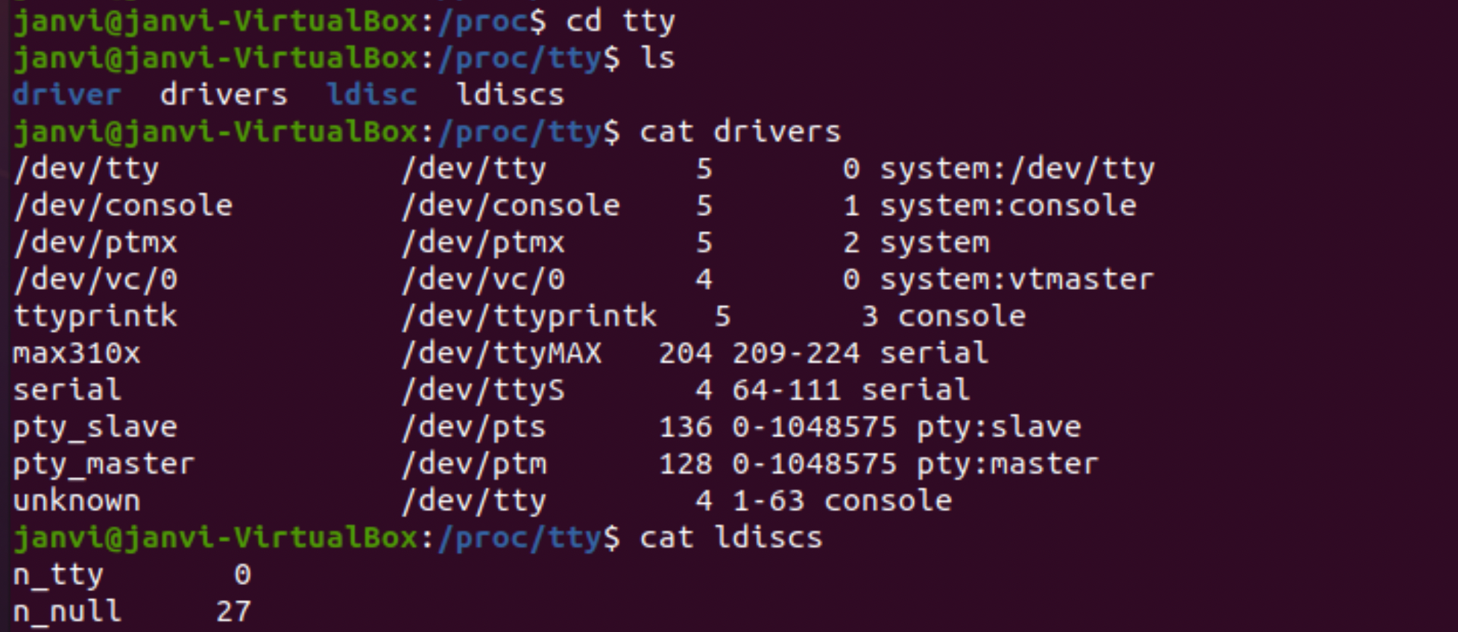

Slide 26
/proc/consoles
This shows registered console line.
Here , the operations , flags and major:minor are the devices and to that we have various flasga and operations attached to it.
Operations: R- read operation , W - write operation , U - unblank
Flags: E - enabled, C - preferred console , B - Primary Boot Console , p - printk buffer , b - braille device , a - safe to use.
Major:minor : major and minor number of devices separated by a colon.

Slide 27
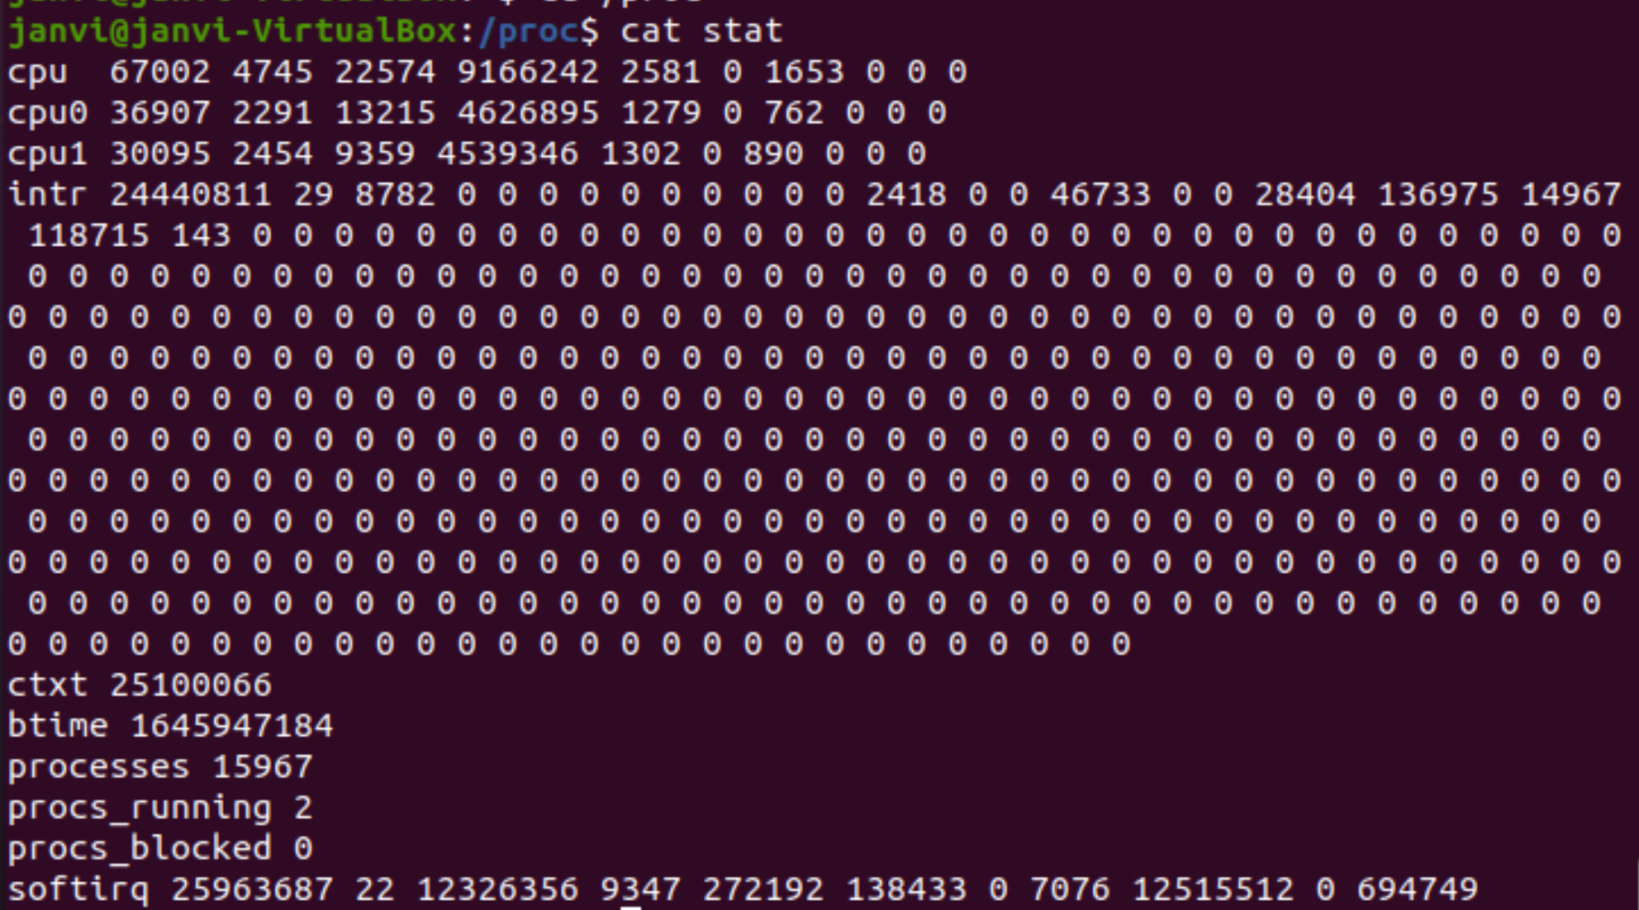
Kernel Statistics in /proc/stat
Information about kernel activity are available in the /proc/stat file.

Slide 28
CPU line: The stat files consists of columns that follows from left to right that shows the amount of time that the CPU has spent while performing these tasks.
user: normal processes executing in user mode
Nice:niced processes executing in user mode
system: processes that are executing in the kernel mode.
idle: twiddling thumbs
iowait: waiting for I/O to complete
irq: servicing interrupts
softirq: servicing softirqs
steal: involuntary wait
guest: running a normal guest
guest_nice: running a niced guest

Slide 29
intr = count of interrupts serviced since the boot time.
ctxt = total number of context switches across all CPUs.
btime = This gives the time at which the system booted.
processes = number of processes and thread created .
procs_running = total number of threads that are running or ready to run
procs_blocked = number of processes that are currently blocked or waiting for the I/O to complete.
softirq = count of softirqs serviced since boot time.

Slide 30
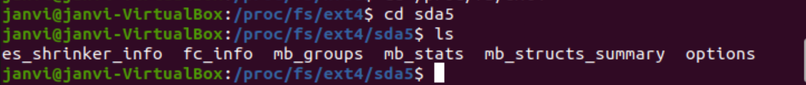
/proc/fs or ext4 file system
/proc/fs consist of the directories and information about the ext4 , jbd2 and nsfd file systems.
Information about mounted ext4 file systems can be found in /proc/fs/ext4.
Jbd2 is the kernel thread of ext4 for updating journals and it is a resource for the ext4 file system. This is for the block journaling which deals with I/O operations and provides a way to check the data integrity.
nfsd - this is a special filesystem that is used for controlling the Linux NFS Server.

Slide 31
